Slide 1
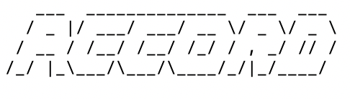
Pavle Rohalj,
Maxwell Rose,
Stefanos Stoikos, Adeline Yu
A secure peer to peer and peer to group chat-room

Slide 2
You will present and demo your final release on November 30, 2020 at 2-5pm. Your presentation should be about 15-20 minutes and should describe (1) the functionality of your system, (2) the design and implementation of your security mechanisms (including threat model, security goals, etc.), (3) your assurance argument. It should also include a demo of your project. This will be your chance to show the rest of the class what you've built!
Your presentation may be done live or may be a pre-recorded video. Either way, all members of the group must participate in the presentation. Time zones permitting, all group members should also attend the final project demos and should be prepared to answer any questions about your group's project.

Slide 3


System purpose
Intent: Provide a secure place for users to chat, with content between them and recipients remaining confidential
Notes:
Our system is an end-to-end encrypted chatroom, with the intent of providing a secure and safe place for users to login and chat. Some of the key features include messaging a user directly, messaging a new group, and messaging a group chat that the user is a part of.
To ensure security, we assume that the central server is not to be trusted, so the server side is unable to see contents of the message, it accesses a separate Database, which checks for account information, and gets the public key and username signed by a separate Certificate Authority.
On the client side, the users will only be able to read and write messages in group chats that they are a member of and direct users.

Slide 4


Security elements
Authentication: User is only able to access chat-room if they create/log-in to their account
Authorization: User is allowed to perform a subset of operations they are authorized for
Audit: System logs events of security significance, f.e. Timestamps of messages, accounts, group chats
Confidentiality: System is unable to see contents of messages between users
Integrity: Users can not modify messages and groups they are not a part of, Server side does not allow for modification of messages and groups
Notes:
Authentication: The user is only able to access and use our application in case they have an account that they create or log in to. After the first log-in with an email verification and a password strength checker, the system stores the account and password in the Database and will require the user to remember their password for the next time.
Authorization: User is allowed to perform a subset of operations they are authorized for. Users can message and view their direct messages to other recipients or group chats they have started or are a part of.
Audit: We log events of security significance, for example, we timestamp each message to prevent replay attacks and we store in our Database existing group chats and accounts.
Confidentiality: Confidentiality of messages between intended users is a main priority in our system. The server is unable to see contents of messages between users and other users can not see messages they are not a part of.
Integrity: Proper file permissions corresponding to the role of the user is maintained in our system. Users do not have permission to modify or view messages and groups they are not a part of and on the server side, we prevent against any replay attacks and messages are locked with AES encryption and an HMAC key.

Slide 5
Features
User can:
Create a password-protected account associated with their email
Log into their account and log out of it
Create groups with other users in the system
Send and receive end-to-end encrypted messages
Direct messages (between two users)
Group messages (between more than two users)
See their current contacts and groups
Issue Slack-like commands to interact with the client application
E.g. :direct alice "Hello, Alice" or :info group testGroup

Slide 6
Features cont.
Messages are stored on the client-side for the duration of the session
Messages are time stamped to prevent replay attacks
A separate, trusted entity (Certificate Authority) issues identity certifications
Users only ever have to interact with the client

Slide 7
Implementation / Security Protocols
Use Pycryptodome for our cryptography
We use 2048 bit RSA
We use the SHA 256 Hash Algorithm for signatures
We use 32 bit symmetric keys
Symmetric encryption done with AES-CBC
We use an HMAC function to create a tag for symmetric encryptions
Notes:
We use the python pycryptodome package for all of our cryptography. We use a 2048 bit RSA algorithm for asymetric encryption and use a SHA 256 Hash Algorithm to create signatures sent with that RSA encyption. Our symmetric keys are 32 bit and are used in AES Cipher block chaining to encrypt messages and an HMAC function is used to create tags for those encrypted messages.

Slide 8
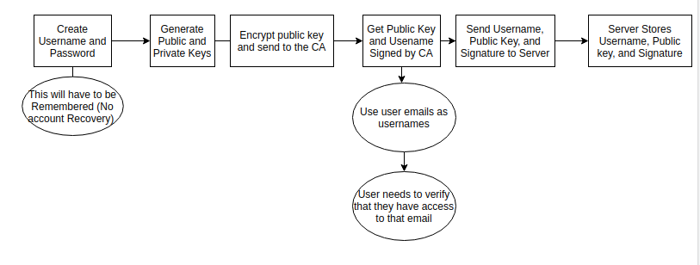
Implementation / Security Protocols cont.
Account Creation
Randomly generate public/private key pair
CA sends an email to verify that the user owns the email address
CA signs the public key and username with the CA’s private key and public key, username, and signature are stored on the server
A user chooses a secure password and the private key is encrypted and stored on the server
Notes:
To access our system, a user must create an account. The process is outlined in the diagram at the bottom. To do this, they are asked for a username and a password. The username needs to be an email they have access to. After this, a private and public key are generated for the user. The public key will be sent over a secure connection to the certificate authority. The CA then sends an email to the user and asks for them to enter a code they received, to verify they do indeed have access to their email username. Once the code is entered correctly, the CA will sign the public key along with the username using its secret private key, so that the user’s public key can be verified by everyone using the distributed CA public key. Once this is complete, the user’s private key is encrypted and stored on the server using a key derived from the password they chose, so that it does not have to be saved locally.

Slide 9
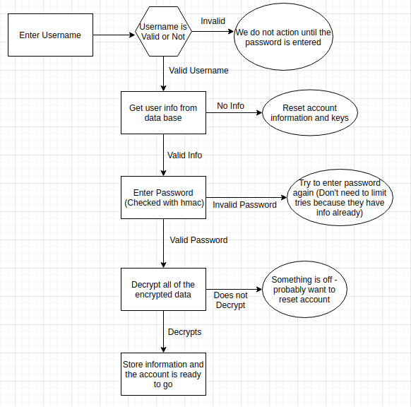
Implementation / Security Protocols cont.
Logging In
Personal information stored on the server
Encrypted with AES-CBC with a key derived from the user’s password
Tagged with an HMAC function with a key derived from the user’s password
The user’s password is not stored or known by anyone but the user
Anyone can request an individual's data, but the password is needed to decrypt
Notes:
After creating an account, the user is asked to login. The process is outlined on the right of the screen. In our system, this means that they are requesting the stored information related to their account, which is their private key and all of their contact information containing previously shared keys. All of this information is encrypted, signed, and stored on the server as it is created using the keys derived from the user’s password. When a user logs in, they just need to verify the integrity of the contents and decrypt the information using their password. In this system, passwords are not stored and account recovery would not be possible. Also, we designed the system in a way that makes it so the user’s stored info does not reveal any personal information unless you have the password. This makes it so a user’s information is private from attackers, but also from the server that is storing the information.

Slide 10
Implementation / Security Protocols cont.
Messaging
The recipient’s public key is retrieved from the server and the signature is verified using the known CA public key
A symmetric key is generated and encrypted with the recipient’s public key and signed with the user’s private key
The signature is verified and both parties save two keys derived from the original key
Messages are then encrypted with AES-CBC using one key and tagged using an HMAC function with the other
Timestamps are sent with the messages in order to defend against replay attacks
Notes:
Once logged in, When a user wants to message someone, our program will first retrieve the recipients public key from the server and validate that the signature created by the CA is correct. We then send a message containing a symmetric key to that user, which is encrypted with RSA, and we will send a signature containing the key, user, and recipient for integrity. The signature is verified by the recipient and both parties save two keys derived from the shared key. Then, messages between the two users are encrypting using AES with cipher block chaining using one key and a tag is created over the message contents using the other. WIth this method, the two users can talk securely and verify the integrity of the messages. We extend this method to group chats by distributing the shared key in the same way to all of the involved parties. Also, timestamps are sent and signed with all of the messages sent to defend against replay attacks.

Slide 11
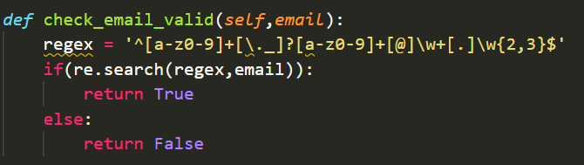
Assurance
Assurance Argument Analytic / Synthetic Trust
Trusted Computing Base
Limited the scale of it to just the Client and the Certificate Authority
Server serves as a relayer of messages and requests
We limit users’ ability to interact with internal parts of the system
If-statements for valid inputs
Placeholder-values when retrieving from database
Figure 2: Using placeholders values; preventing SQL injection attacks
Figure 1: Format-checking email

Slide 12
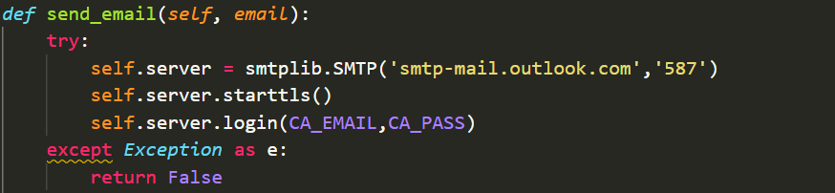
Assurance
To certify that the components of the system worked correctly we used:
Bug finding tool pylint to scan for low level bugs
Auto formatter autopep8 to catch outdated modules
Mypy to do static type checking on crypto functions
Unit-testing to check reliability of functions:
Isolated component testing (adding elements to database)
Integration testing (direct messaging)
try/except blocks to prevent System Errors and handle them early
Manual System testing aided with scripts / boundary cases list
Figure 3: Checking if connection with mailing service is established

Slide 13
Signup two users
Send messages between the two users
Signup another user
Send message to the new user
Create a group with all of them
Send to group
Logout of everyone, log back in
Show all the information is there (:contacts, :groups, :groupinfo)
(Maybe show something else here)
Logout
Show some of our security features
Invalid password
Invalid username
Password strength
Email verification ?
<demo time>

